Slide 1
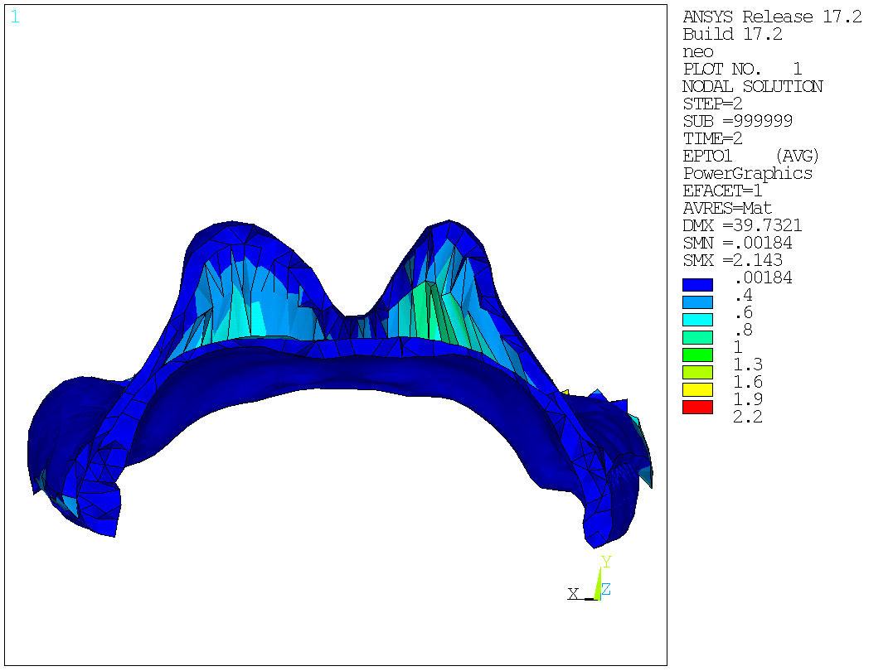
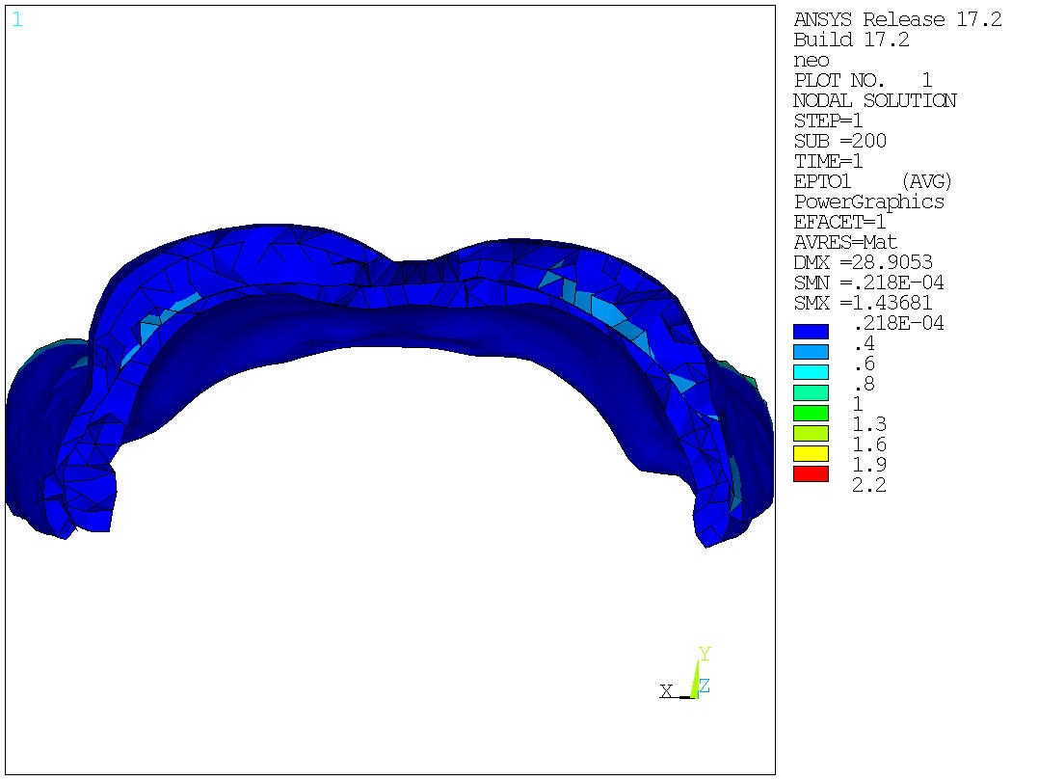
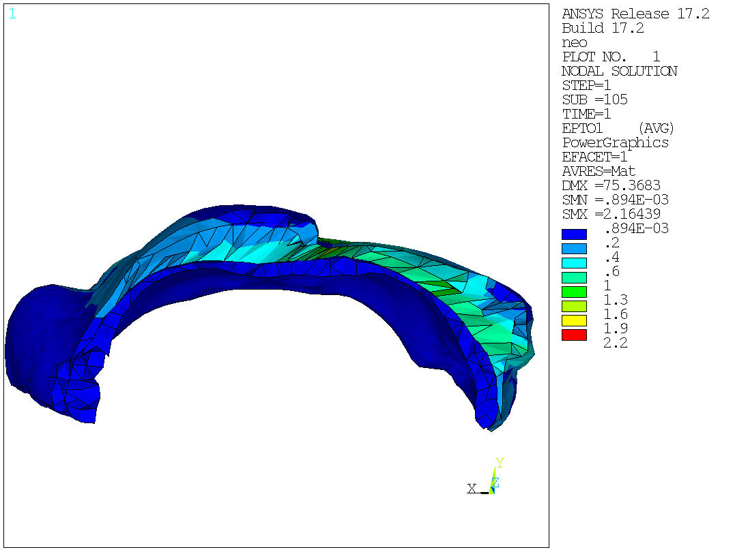
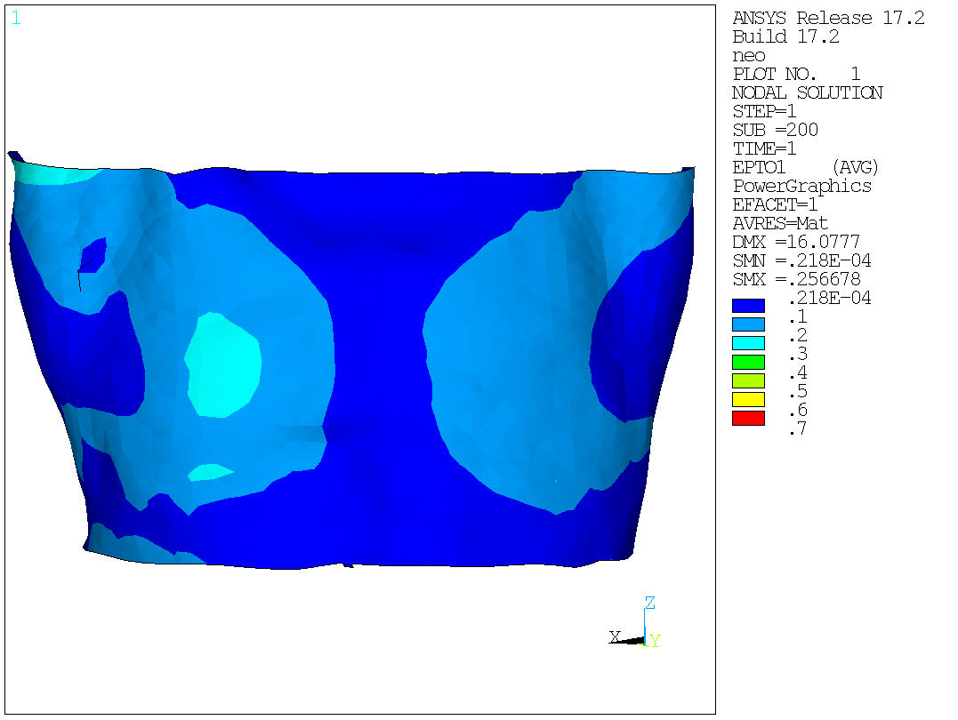
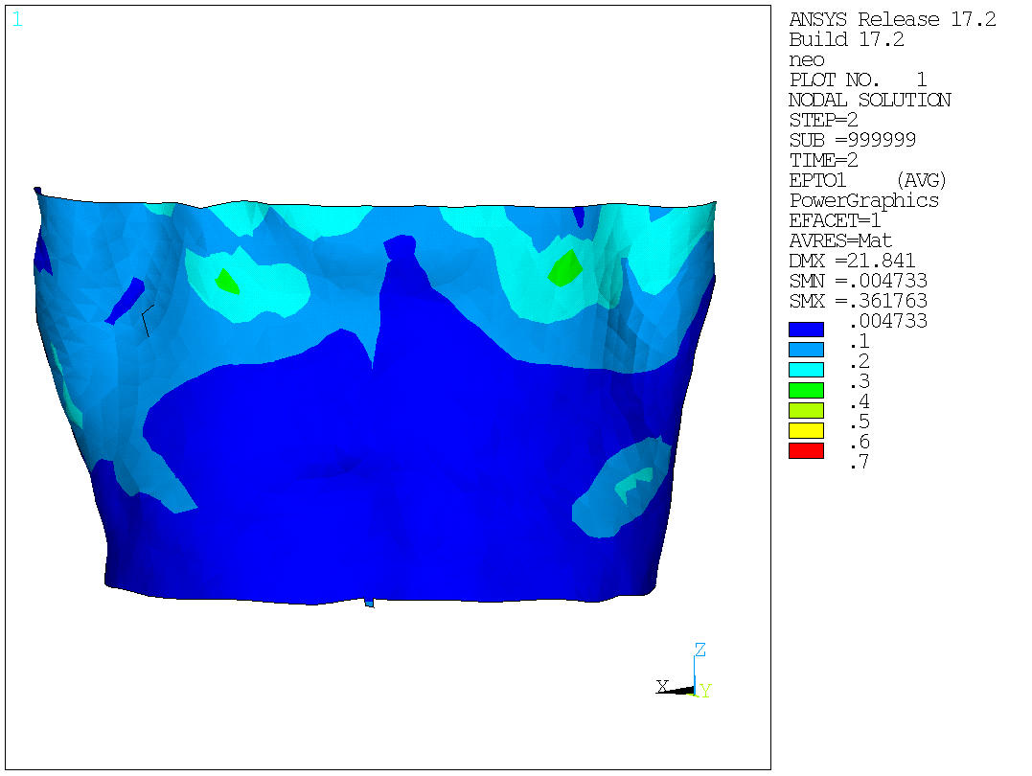
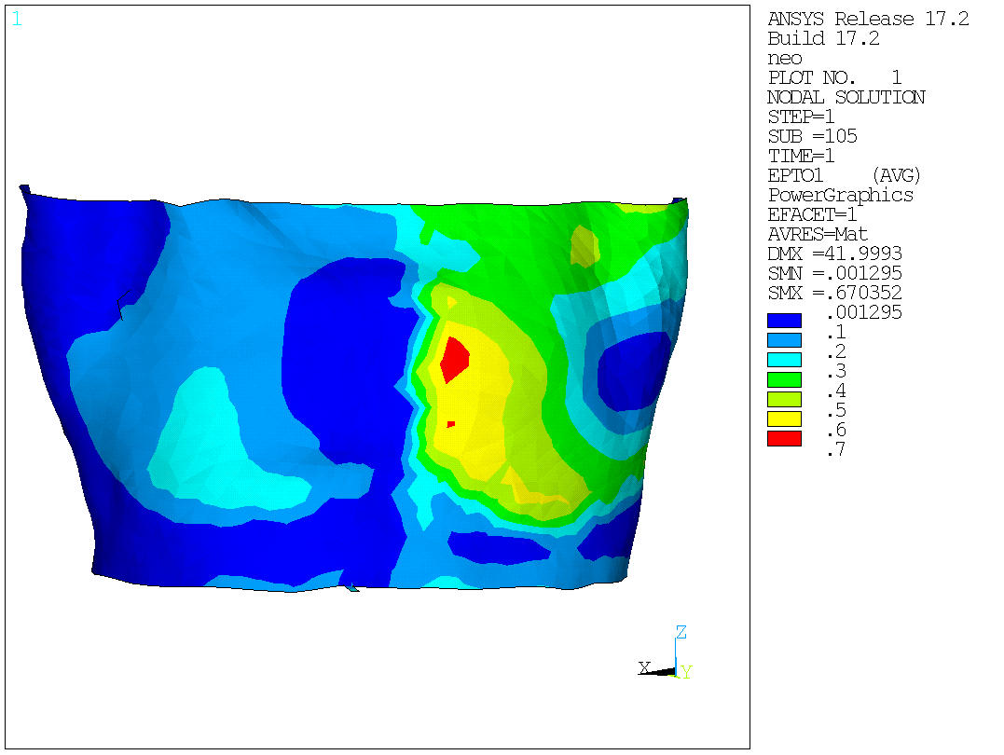
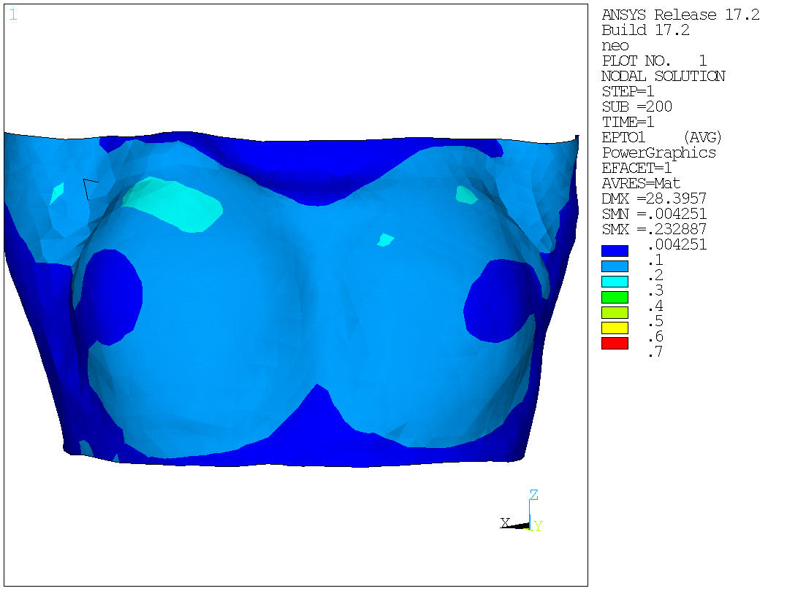
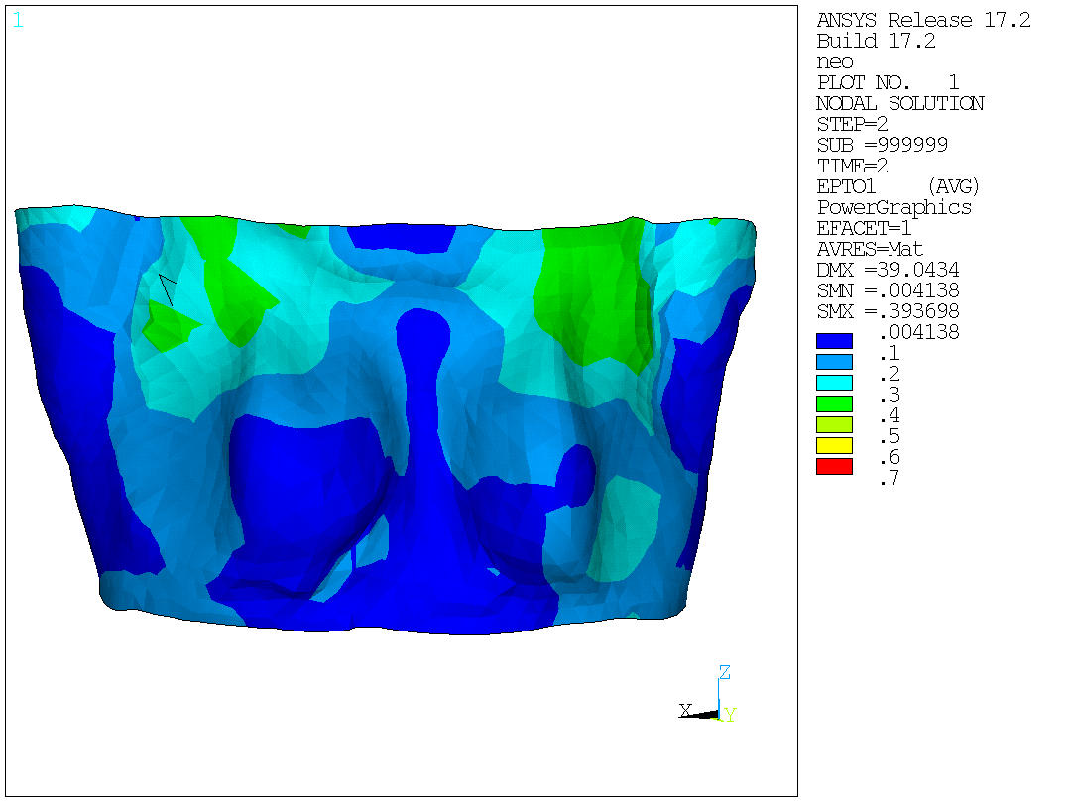
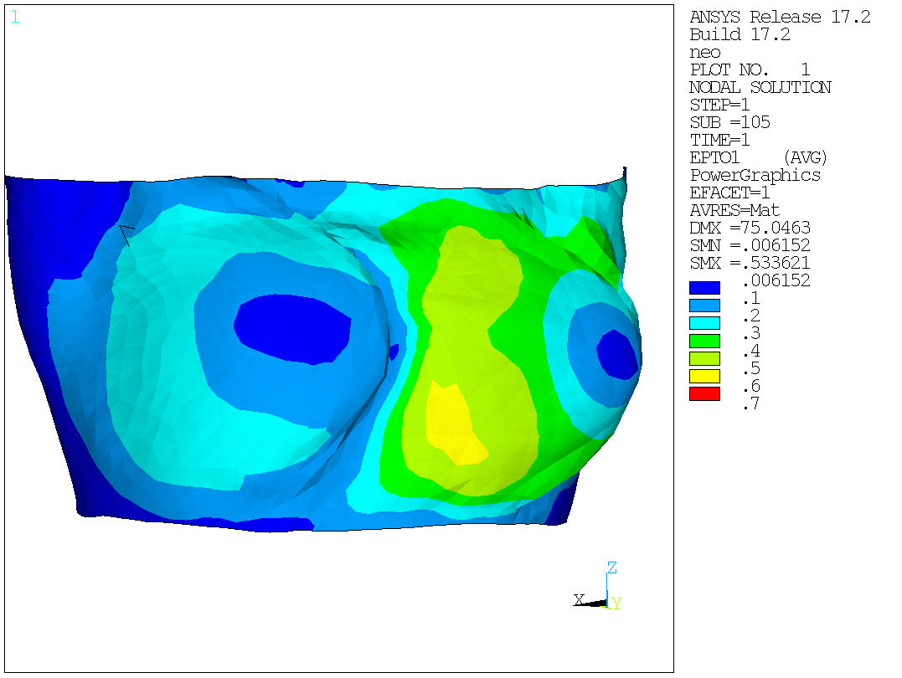
Supine Prone Supine tilted
Breast tissues
Max = 1.43
Max = 2,14
Max = 2,16
Fascia surface
Max = 0,25
Max = 0,36
Max = 0,67
Skin surface
Max = 0,23
Max = 0,39
Max = 0,53

Slide 2
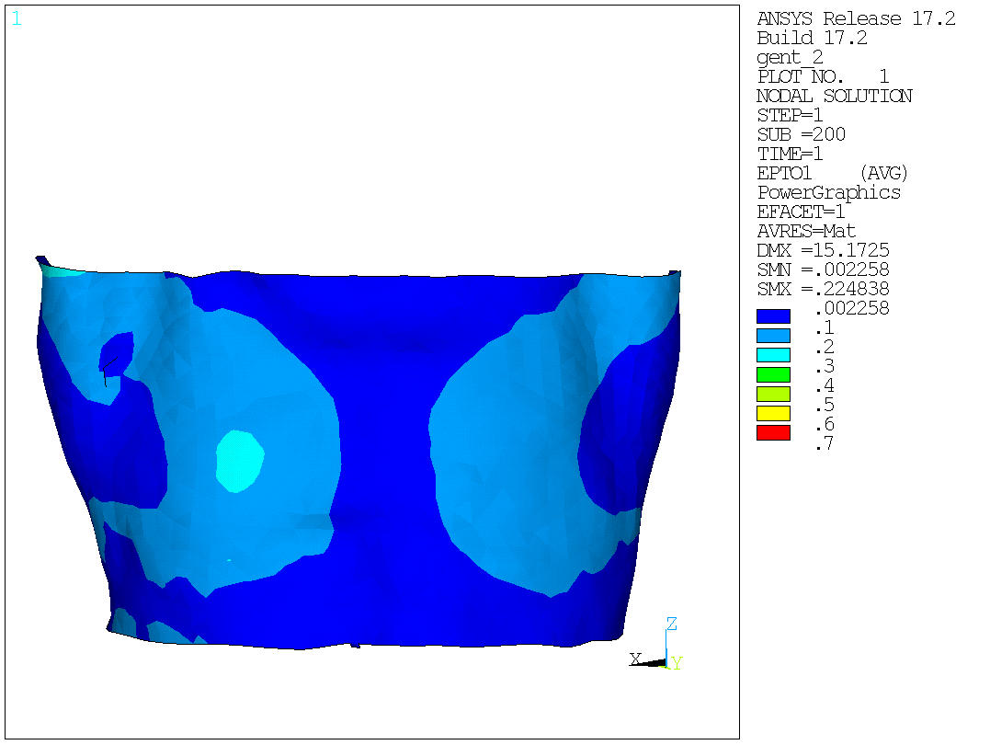
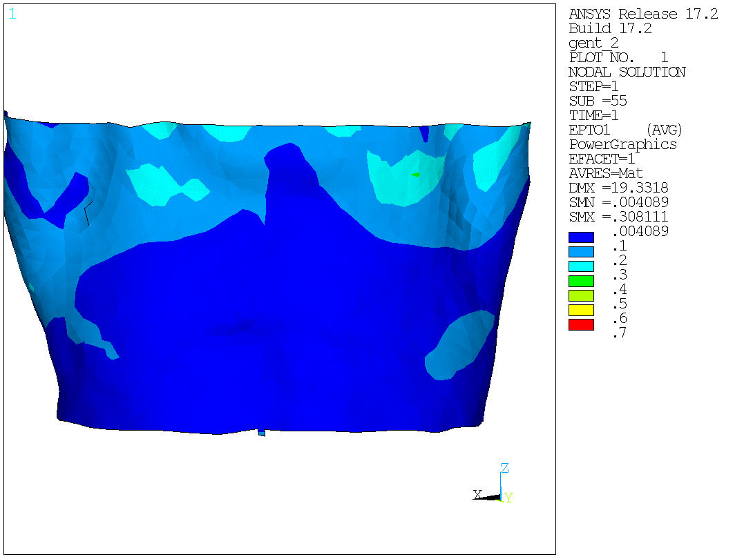
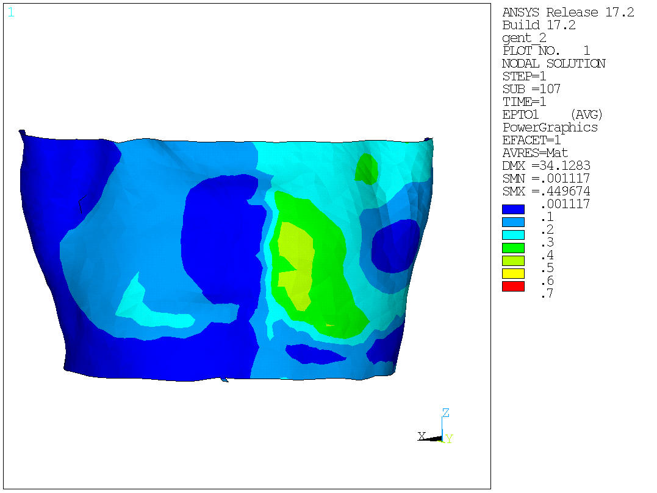
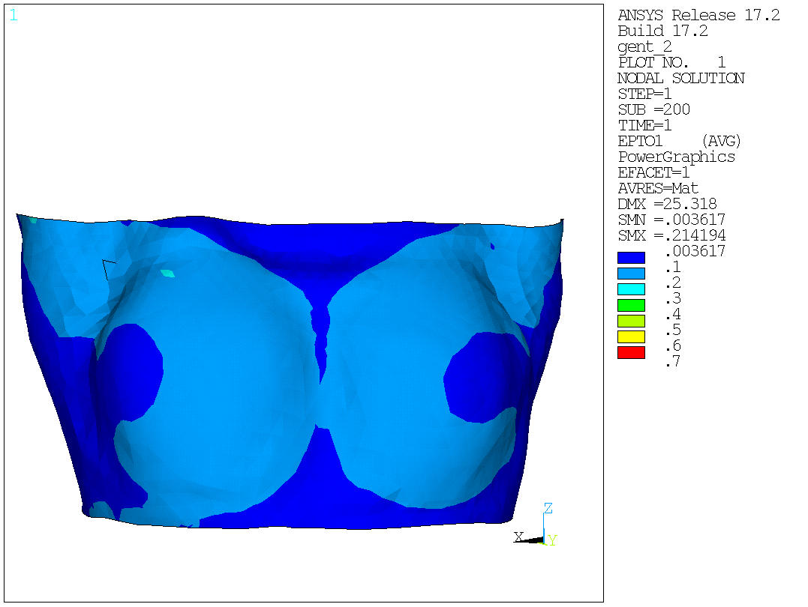
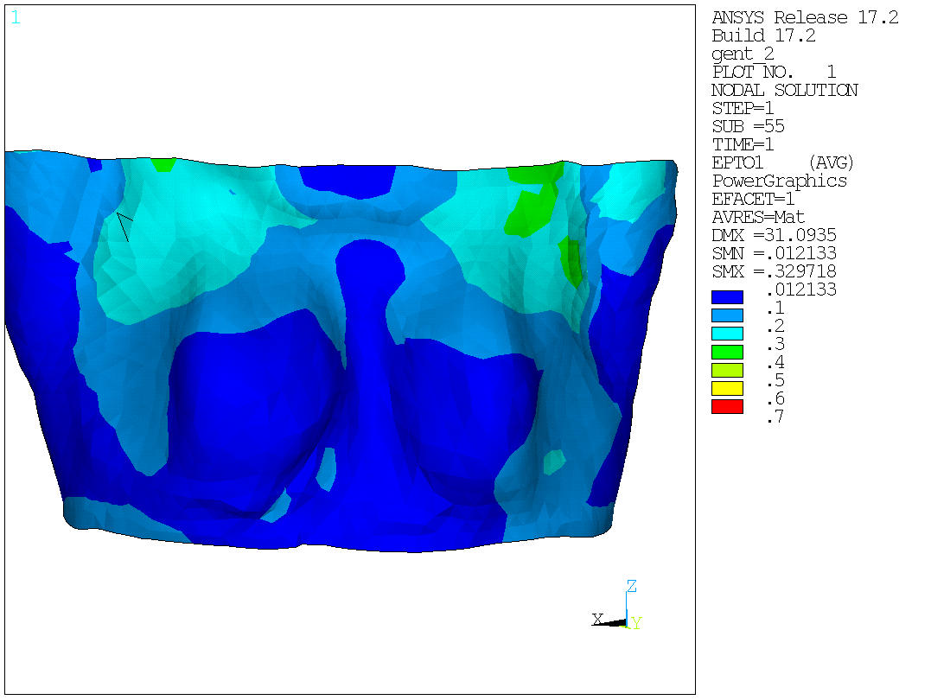
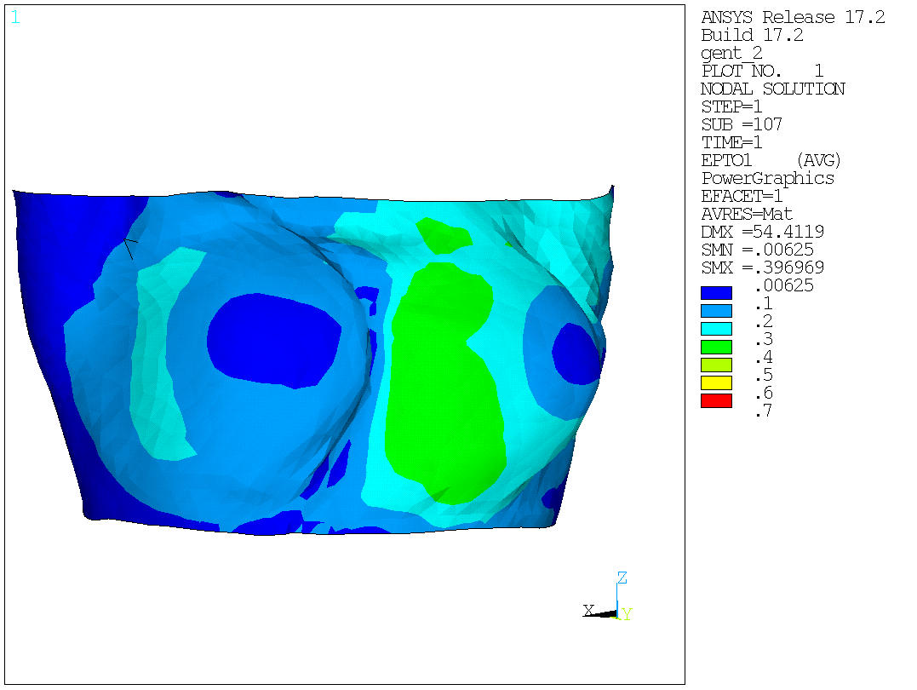
Supine Prone Supine tilted
Fascia surface
Max = 0,22
Max = 0,32
Max = 0,44
Skin surface
Max = 0,21
Max = 0,39
Max = 0,39

Slide 3
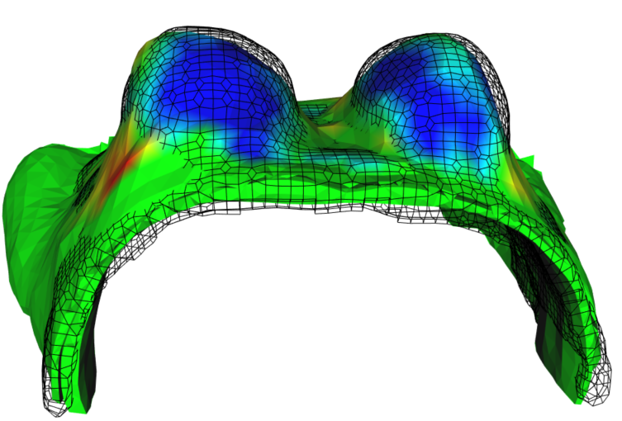
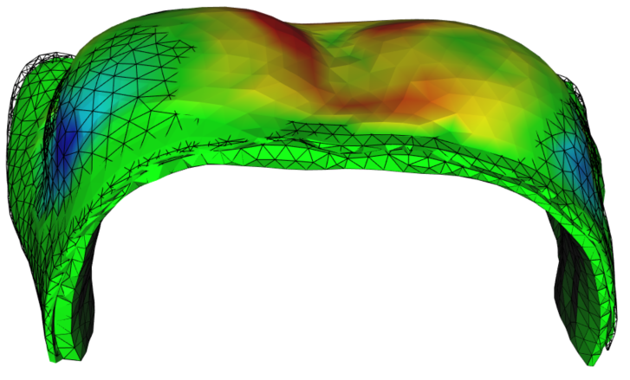
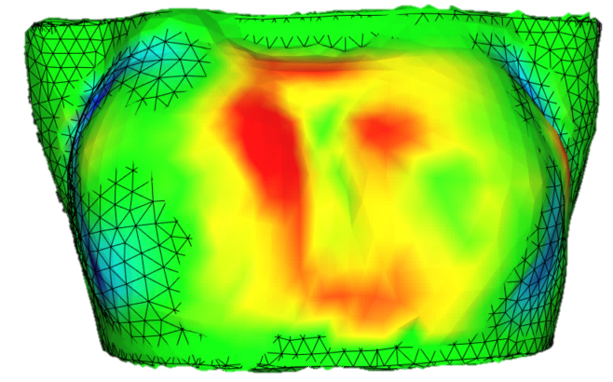
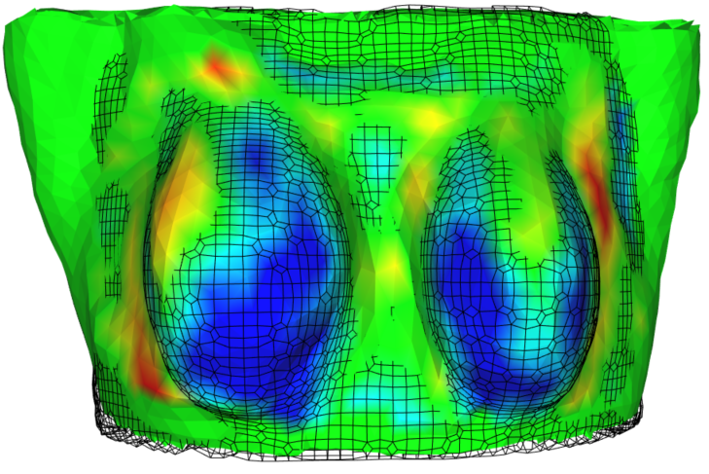
Prone
Supine
Hausdorff distance (mm) | 2.56
Mean distance ± std (mm) | 1.89 ± 1.80
Max distance (mm) | 10,19
Hausdorff distance (mm) | 2.10
Mean distance ± std (mm) | 2.10 ± 1.56
Max distance (mm) | 8.46
Point to surface distance (mm)
Point to surface distance (mm)

Slide 4
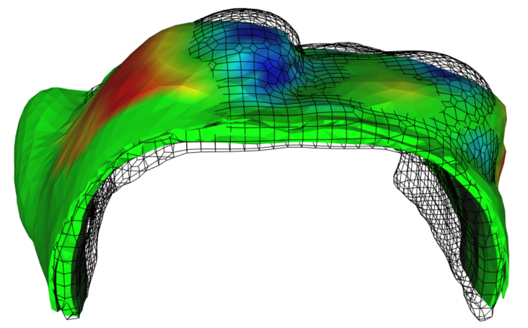
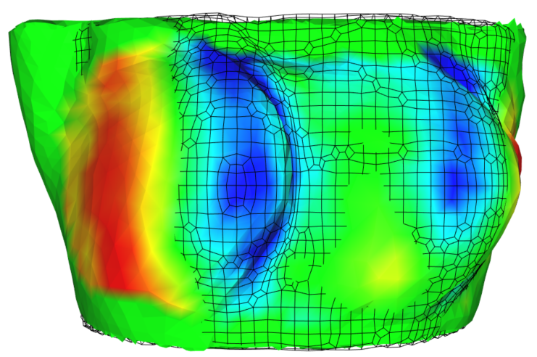
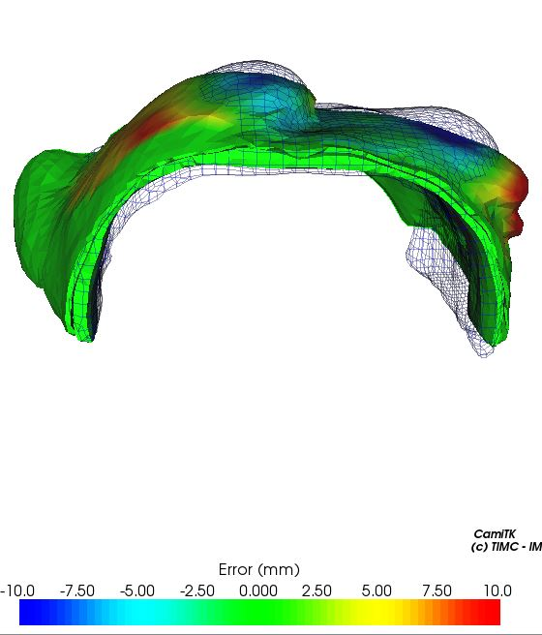
Supine tilted
Hausdorff distance (mm) | 5.15
Mean distance ± std (mm) | 5.15 ± 3.33
Max distance (mm) | 16.03
Point to surface distance (mm)

Slide 5
